Slide 1
Chapter 5 Intermediate Representations II

Slide 2
The Rest of the Story…
Last class we looked at representations for code
Representing the code is only part of the story.
The compiler must also represent the name space of the program.
The name space of a program includes procedures, objects, variables, structures, types, built-in functions, …
Symbol table
Constant table
Representation, type
Storage class, offset
Storage map
Overall storage layout
Overlap information
Virtual register assignments

Slide 3
IRs and Name Spaces
To generate code, the compiler needs more than just the code
Need to represent the name space of the code being compiled
Declarations for variables, procedures, aggregate values, types, objects, classes, constants, system services, …
For each name, the compiler needs a mechanism to compute its address
For many names, the compiler needs detailed structural information
All of that knowledge must be organized and quickly accessible

Slide 4
How does the compiler know … ?
In most cases, names are declared, either explicitly or implicitly
The compiler parses the declarations; it must record the information associated with names.
For example, for a variable it needs
data type
storage class
name and
lexical level of its declaring procedure
a base address and offset in memory
The compiler needs a repository that associates attributes with names. This central repository is called a symbol table.
A compiler has one or more symbol tables
Fast lookup of attributes by name
Must be scalable and inexpensive
Strongly suggests a hash table

Slide 5
A Compiler’s Symbol Table: a single name space
Symbol table
Initial entries inserted by parser, elaborated as compilation progresses.
As compiler generates new temporary names, it adds them, too.
The symbol table interface
1. LookUp(name) returns the record stored in the table at h(name) if one exists. Otherwise, it returns a value indicating that name was not found.
2. Insert(name, record) stores the information in record in the table at h(name). It may expand the table to accommodate the record for name.
Might need to keep the symbol table around for debugging
Would like the ability to write the symbol table to disk and read it back
Whole process should scale nicely

Slide 6
A Compiler’s Symbol: Table a single name space
Table has an entry for every name that the compiler knows
Variables, labels, procedures, classes, system calls, …
Entry for a name has a whole bunch of associated fields
Lexeme, type, address, length, storage class, declaring scope, …
Name | Type | Addr | Len | SC | …
y | int | 8 | 4 | local
x | char | 12 | 0 | static
z | double | 0 | 8 | local
Conceptual image of a symbol table
h(y)
The compiler can use y’s table index, h(y), as a short name for y in the IR

Slide 7
A Compiler’s Symbol Table: a single name space
Information in the symbol table implies a storage map
h(y)
Name | Type | Addr | Len | SC | …
y | int | 8 | 4 | local
x | char | 12 | 2 | static
z | double | 0 | 8 | local
z |  |  |  |  |  |  |  | y |  |  |  | x
0 | 1 | 2 | 3 | 4 | 5 | 6 | 7 | 8 | 9 | 10 | 11 | 12 | 13
Storage map implied by the symbol table

Slide 8
Of course, it is not that simple …
Large programs would be impractical if each name had to be unique
PL’s introduce scopes of names
Each “scope” creates a new name space
Typical scopes are procedures, blocks, objects, files (or modules)
Well defined rules for inheriting & obscuring names from outer scopes
New scope implies a clean name space
Local declaration hides same name in an outer scope
Rules arbitrate clashes of names and declarations
Common case: lexical scoping

Slide 9
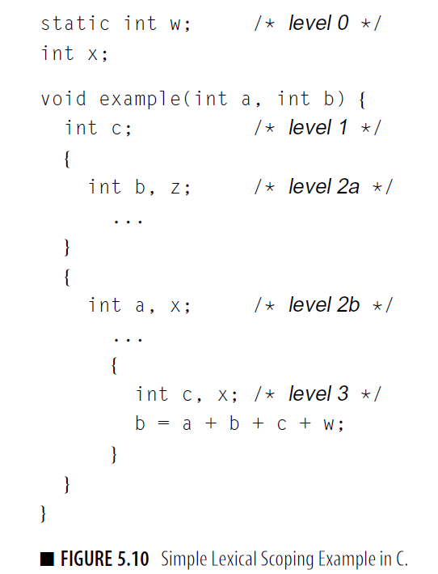
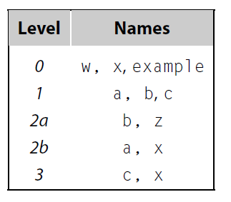

Using subscripting names to show their level

Slide 10
Lexical Scoping in an Algol-like Language
Each scope ( procedure or block ) creates its own name space
Any name (almost) can be declared locally
Local names obscure identical non-local names
Local names cannot be seen outside the procedure
Scopes are searched in the order that they were encountered
Examples
Algol and Pascal are the classic examples
Nested procedures, often with deep nesting
C has global, static, local, and block scopes (actually Fortran-like)
Blocks can be nested, procedures cannot
Scheme has global, procedure-wide, and nested scopes
Procedure scope (typically) contains formal parameters

Slide 11
Lexical Scoping Example
procedure p {
int a, b, c
procedure q {
int v, b, x, w
procedure r {
int x, y, z
….
}
procedure s {
int x, a, v
…
}
… r … s
}
… q …
}
B0: {
int a, b, c
B1: {
int v, b, x, w
B2: {
int x, y, z
….
}
B3: {
int x, a, v
…
}
… r … s
}
… q …
}
Algol-like language
Block scopes in C

Slide 12
What does Lexical Scoping buy us?
Lexical scoping defines the shape of the name space
Simplifies rules for naming & resolves conflicts
Let the programmer introduce “local” names with impunity
The Questions
At point p, which declaration of x is current?
At run-time, where is x found?
As parser goes in & out of scopes, how does it create & delete new x’s?
The Answer
The compiler needs structures that model both the creation and the destruction of scopes
Compilers use lexically-scoped symbol tables for this purpose

Slide 13
Naming Needs Support at Different “Times”
At compile time, compiler must map an id back to a declaration
Which declaration of x does this use reference?
What are its properties?
How can the compiler compute its runtime address?
At runtime, the code must place x’s in storage & compute its address
Different mechanisms for different storage classes
Global, static, local, heap, register, …
The mechanisms need to work, even with separate compilation
Call to fee(), where fee is defined in another file
Naming requires coordination between compile time and runtime
Compiler needs to represent names in ways that make sense at both compile time and runtime

Slide 14
Primer on Lexically-scoped Symbol Tables
The problem
The compiler needs a distinct record for each declaration
Nested lexical scopes admit duplicate declarations
The interface
insert(name, level ) – creates record for name at level
lookup(name, level ) – returns pointer or index
delete(level ) – removes all names declared at level
Many implementation schemes have been proposed (see § B.4)
We’ll stay at the conceptual level
Hash table implementation is tricky
Good alternatives exist
Symbol tables are compile-time structures that the compiler uses to resolve references to names.
We’ll see the corresponding run-time structures that are used to establish addressability later.

Slide 15
Example
procedure p {
int a, b, c
procedure q {
int v, b, x, w
procedure r {
int x, y, z
….
}
procedure s {
int x, a, v
…
}
… r … s
}
… q …
}
B0: {
int a, b, c
B1: {
int v, b, x, w
B2: {
int x, y, z
….
}
B3: {
int x, a, v
…
}
… r … s
}
… q …
}
Remember this point
Algol-like language
Block scopes in C

Slide 16
Lexically-Scoped Symbol Tables
High-level idea
Create a new table for each scope
Chain them together for lookup
procedure p {
int a, b, c
procedure q {
int v, b, x, w
procedure r {
int x, y, z
….
}
procedure s {
int x, a, v
…
}
… r … s
}
… q …
}
...
“Sheaf of tables” implementation
insert() may need to create table
it always inserts at current level
lookup() walks chain of tables &
returns first occurrence of name
delete() throws away the table
If the compiler must preserve the table (for, say, the debugger ), this idea is actually practical.
Individual tables are hash tables.
p
Remember this point
q
r
b
•
x
v
a
...
y
b
c
x
w
z

Slide 17
Implementing Lexically-Scoped Hash Tables
Open Hashing (conceptual view)
procedure p {
int a, b, c
procedure q {
int v, b, x, w
procedure r {
int x, y, z
….
}
procedure s {
int x, a, v
…
}
… r … s
}
… q …
}
•
x
x
In open hashing, sometimes called a bucket hash, the hash function maps the key to a bucket, and the item is found by walking the chain of records
insert () finds h(x) and adds a new record for x at the head of the list
lookup () goes h(x) and walks the list looking for x, first found on in higher level
delete () walks the list for the level, deletes the records, and fixes the lists
Performance depends on sparsity
With “enough” slots, collisions in h can be infrequent ⇒ O(1) expected case
•
z
b
b
•
h (x)
•
y
w
•
v
a
Level | Procedure
3 | r
2 | q
1 | p
•
c
Sparse index

Slide 18
Implementing Lexically-Scoped Symbol Tables
Open Hashing with a Threaded Stack
procedure p {
int a, b, c
procedure q {
int v, b, x, w
procedure r {
int x, y, z
….
}
procedure s {
int x, a, v
…
}
… r … s
}
… q …
}
Behaves like the simple open hash, except:
insert () allocates records at the top of the stack
delete () runs down the stack to the start of the next procedure, deleting records & fixing up the lists
Advantage
Simpler allocation of records
Simpler deletion
Easy I/O
Easy to expand index to maintain sparsity
•
growth
•
•
z,3
h (x)
y, 3
•
x,3
r
w, 2
•
x, 2
b, 2
v, 2
q
c, 1
b, 1
•
a, 1
p
Sparse index
Dense table
Parser (or treewalk) encounters names by scope, so each scope forms a block at stack top.

Slide 19
Back to the Big Picture
The parser builds an initial symbol table
Enters names as they are declared or encountered
Context-sensitive analysis fills in more information
might compute types, storage classes, offsets in data areas, lengths, indication of whether it can be kept in a register
Build a table for each scope and associate it with the scope
End up with a tree of tables

Slide 20
Example
procedure p {
int a, b, c
procedure q {
int v, b, x, w
procedure r {
int x, y, z
….
}
procedure s {
int x, a, v
…
}
… r … s
}
… q …
}
x
y
z
r
v
b
x
w
a
b
c
x
a
v
p
q
s
Algol-like language
Tree of Symbol Tables
Algol-like language

